Slide 1


Final Year Project Proposal
Connect the Color Dots
(An IQ Test Puzzle Game)
Supervised By: Mansoor Alam (professor)

Slide 2
Project Team
Muhammad Nofal Ullah
(29409)
Sulman Siddique
(22816)
Uzair Asif
(22664)

Slide 3
Table of Content
Introduction and Background
Literature Review and Summary Table
Gap Analysis
Problem Statement
Proposed Solution & Methodology
Project Scope
Work Breakdown Structure
Roles and Responsibilities

Slide 4
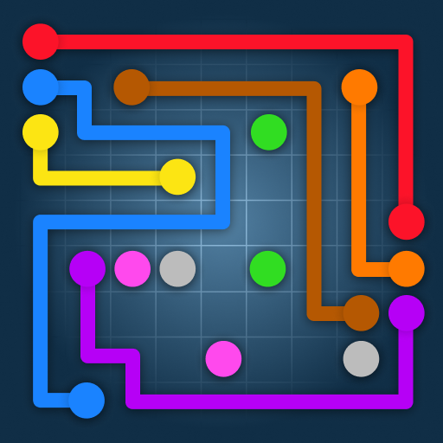
INTRODUCTION AND BACKGROUND
Android base Application
Test IQ level
Enhance cognitive Abilities

Slide 5
Connect the Color Dots is an Android-based application aimed at checking the IQ level of users through a puzzle game.
The game requires users to connect dots of the same color to solve puzzles, gradually increasing in complexity.
Players receive an estimated IQ score upon completing the levels, enhance their analytical and problem-solving skills.

Slide 6
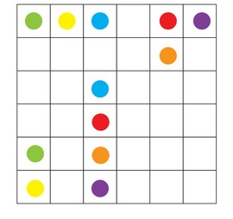
LITERATURE REVIEW
Simple Connect Dots games
No Modern Features

Slide 7
Paper name | Author | Techniques | Results | Efficiency | Advantage’s | Disadvantages
Effects of Dot-Based Puzzle Games on Working Memory | Kuo et al. | 1- User Testing. 2- User testing plan 3- Quantitative and qualitative analysis | playing dot-based puzzle games improved working memory performance compared to non-gaming controls. | Efficient but still has some limitations to it. | Developing new skills , Building IQ level , enhancing cognitive ideas . | Playing connect the color dots games too much can hurt your hands and stop you from doing other things. Remember to take breaks and do other stuff too.

Slide 8
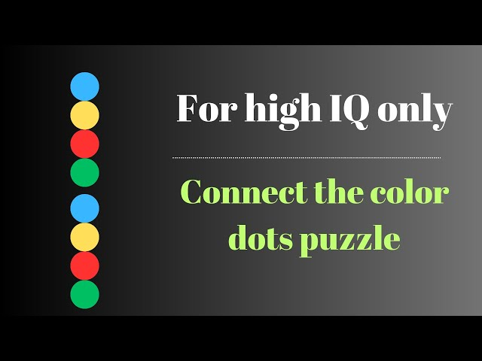
Logic building Mathematically strong Gap Analysis

Slide 9
Although many puzzle games claim to enhance cognitive abilities, most fail to directly link gameplay to IQ scores.
Most well-known puzzle games use the same ideas and designs, without introducing anything new or inventive.

Slide 10
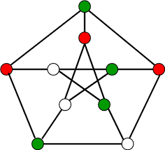
PROBLEM STATEMENT
Incorporating new features
Enhance users' skills
Logic-making abilities.

Slide 11
Even though solving puzzles seems like it might relate to intelligence, there aren't any widely recognized puzzle games that specifically test IQ levels.
The fact that puzzle-solving doesn't directly measure IQ makes it hard to show why our game is valuable.

Slide 12
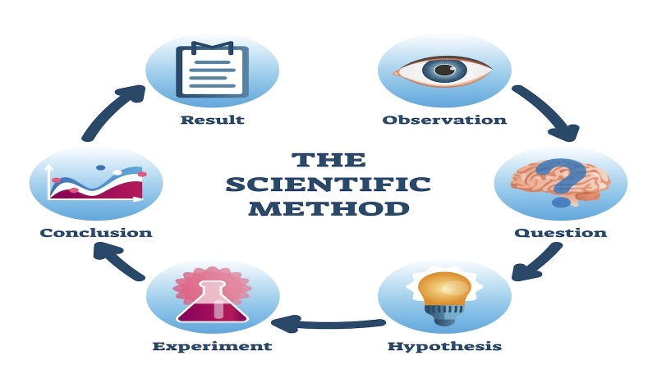
PROPOSED SOLUTION AND METHODOLOGY

Slide 13
Develop a Connect the Color Dots game that estimates IQ levels based on successful completion of puzzles.
Utilize a well-established IQ scale, converting puzzle completion percentiles into corresponding IQ scores.
Continually refine and expand the game with innovative puzzles and features to attract and retain users.

Slide 14
PROJECT SCOPE

Slide 15
Define the boundaries of the project.
Including the target audience of users of all ages.
Focus on enhancing skills and logic through puzzle games.

Slide 16

Work Breakdown Structure

Slide 17
Break down of the project is into three parts.
UI/UX Design
Development
Documentation

Slide 18
Roles and Responsibilities
Documentation
Development

Slide 19
Our project will be done in two phases Documentation and Development.
Documentation will be done in first phase and development will be done in second phase.
working on UI/UX design will be by Uzair Asif.
working on Documentation will be by Sulman Siddique.
working on development process will be by M Nofal Ullah.

Slide 20
Model and Tools
Using Agile Model
Unity 3D for developing
Adobe illustrator for UI and UX
Algorithms
Round Robbin and A*(star)

Slide 21
CONSTRAINTS AND LIMITATIONS

Slide 22
Users must complete the first level before their IQ level can be checked.
If the first level is not yet completed, users cannot proceed to IQ assessment.
Users must fill the entire matrix to progress to the next level.
You must finish filling up the whole grid within the given time limit or attempt count.
If not, you won't be able to move forward in the game.

Slide 23


